Slide 1
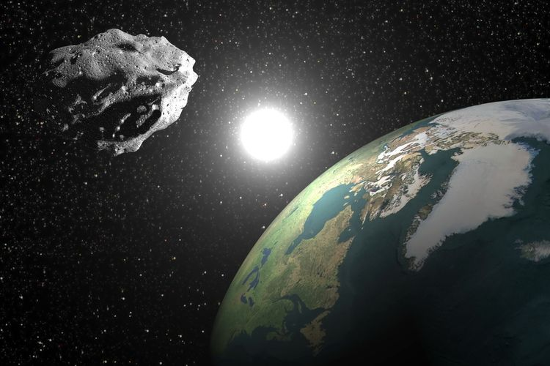
Asteroid Hazardousness Classification
Created by:
Dody Harianto

Slide 2
BUSINESS BACKGROUND

Slide 3

Background
As a Data Scientist at NASA, my main task is to build a machine learning model that can classify asteroids based on their hazardousness.

Slide 4

Business Objectives
The objective of this project is to predict whether an asteroid is potentially harmful to Earth. The main business benefit is to save astronauts large amount of time and energy to make predictions.

Slide 5

Expected Output
The expected output of this machine learning project is the prediction whether an asteroid is hazardous / harmful to Earth.

Slide 6

Project Limitation
Due to less information about several features in my dataset, and limited domain knowledge in astronomy, I only focus on several general and known features like distance and class of asteroids.

Slide 7
ANALYTIC APPROACH
MACHINE LEARNING TECHNIQUE
→ Supervised Learning (Classification)
PERFORMANCE MEASURE
Accuracy
Precision
Recall
F1 Score

Slide 8
DATA UNDERSTANDING

Slide 9
Dataset Overview
Number of Observations: 50000
Number of Variables: 21
Numerical Variables: 18
Categorical Variables: 3
Target Variable: potentially_hazardous
(Y / N)

Slide 10
EXPLORATORY DATA ANALYSIS (EDA)

Slide 11
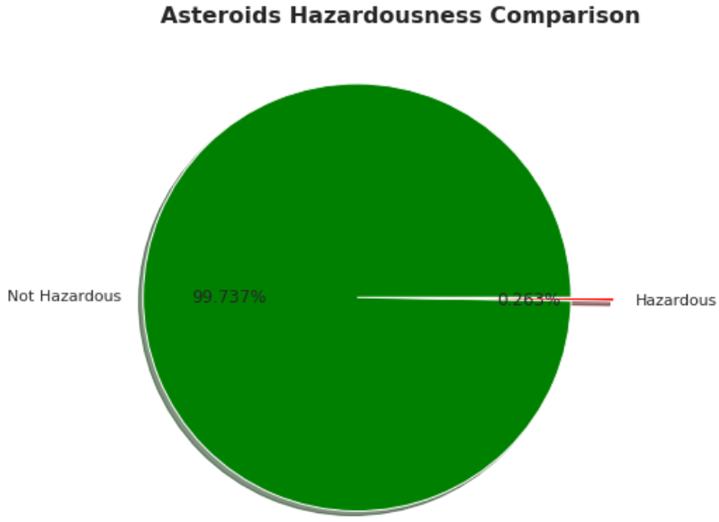
Target Variable (Potentially Hazardous)

Slide 12
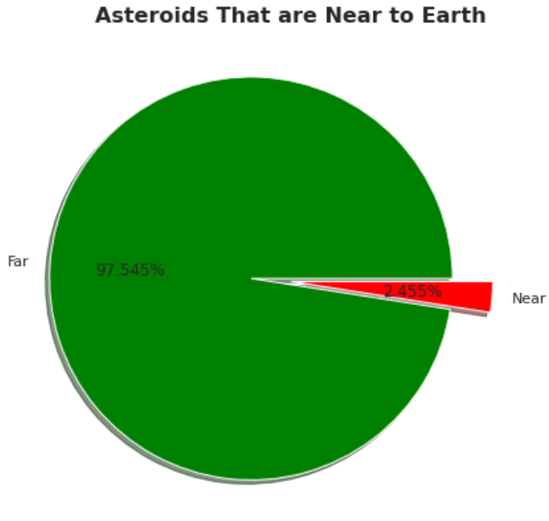
Feature: Near Earth

Slide 13
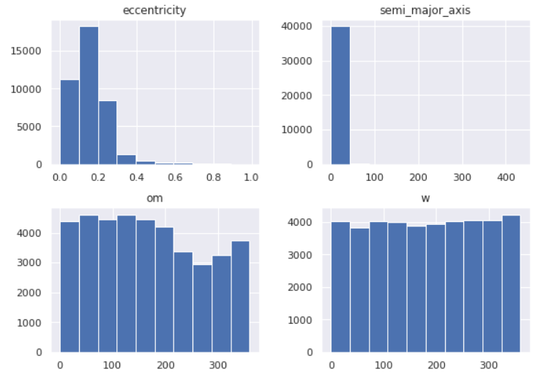
Distributions of Numerical Variables

Slide 14
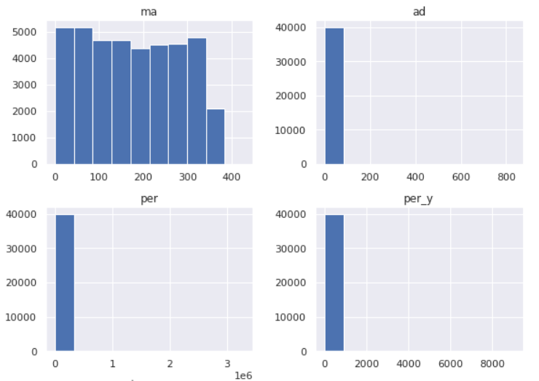
Distributions of Numerical Variables

Slide 15
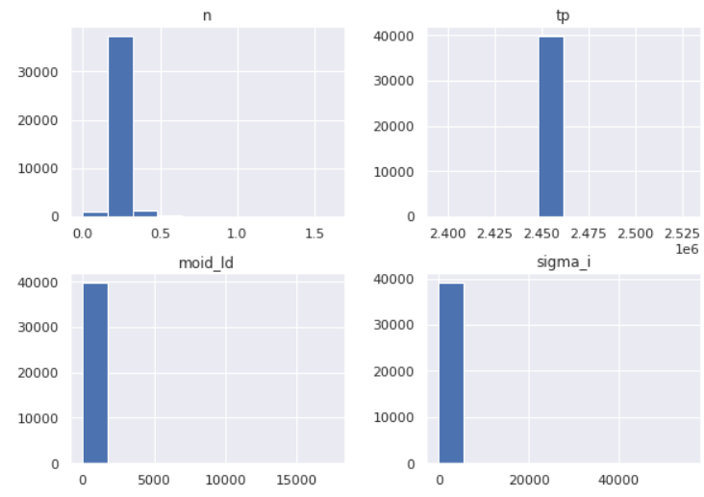
Distributions of Numerical Variables

Slide 16
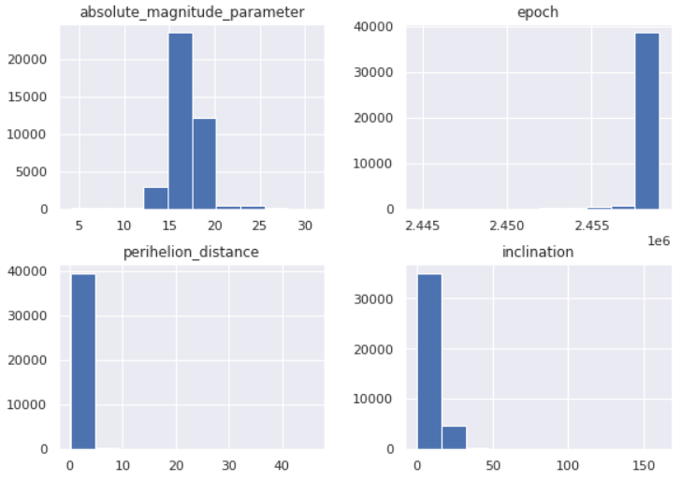
Distributions of Numerical Variables

Slide 17
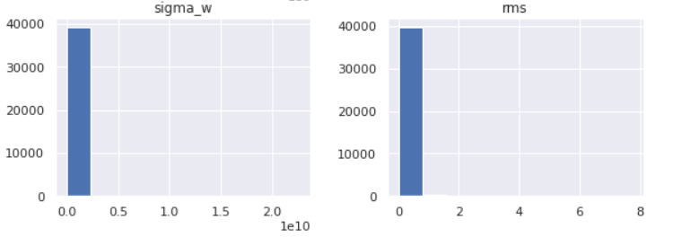
Distributions of Numerical Variables

Slide 18
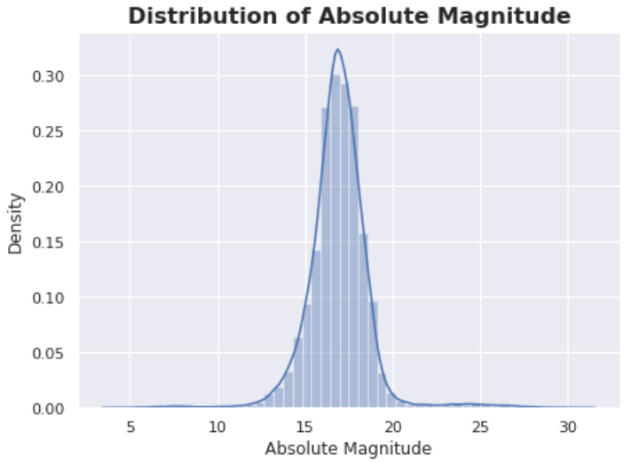
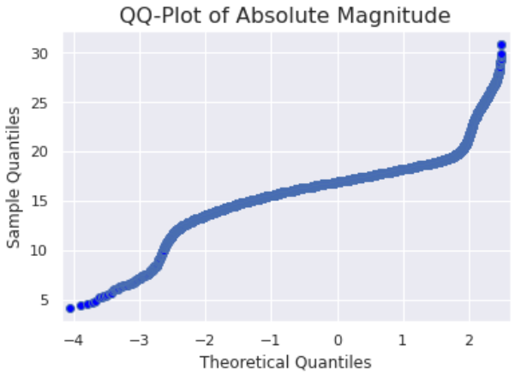
Distributions of Absolute Magnitude
Absolute magnitude is the visual magnitude an observer would record.
Histogram
QQ-Plot

Slide 19
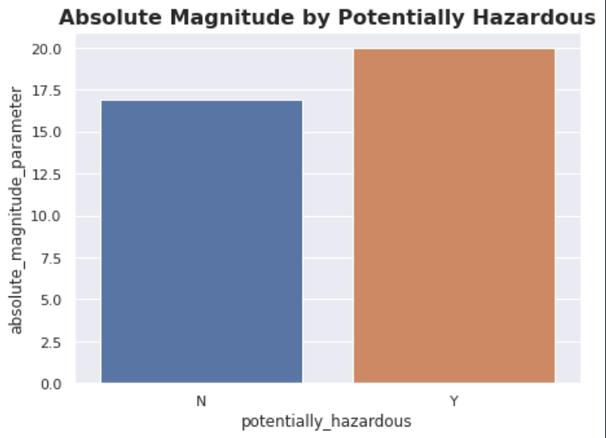
Absolute Magnitude vs. Potentially Hazardous

Slide 20
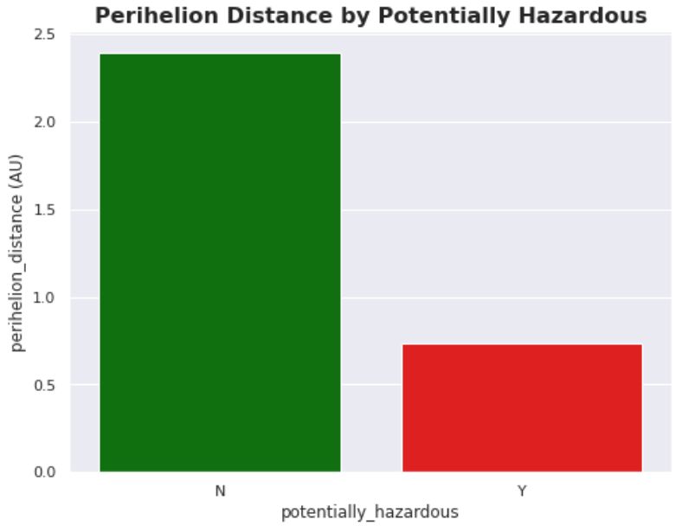
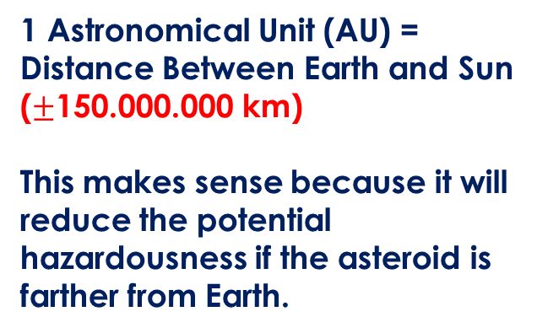
Perihelion Distance by Hazardousness
1 Astronomical Unit (AU) = Distance Between Earth and Sun
($±$150.000.000 km)
This makes sense because it will reduce the potential hazardousness if the asteroid is farther from Earth.

Slide 21
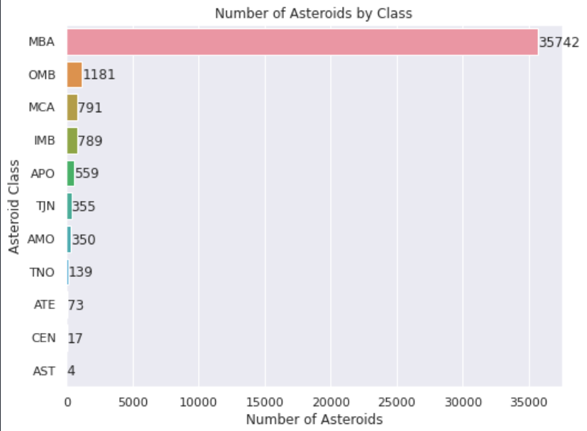
Number of Asteroids by Class

Slide 22
PREPROCESSING

Slide 23
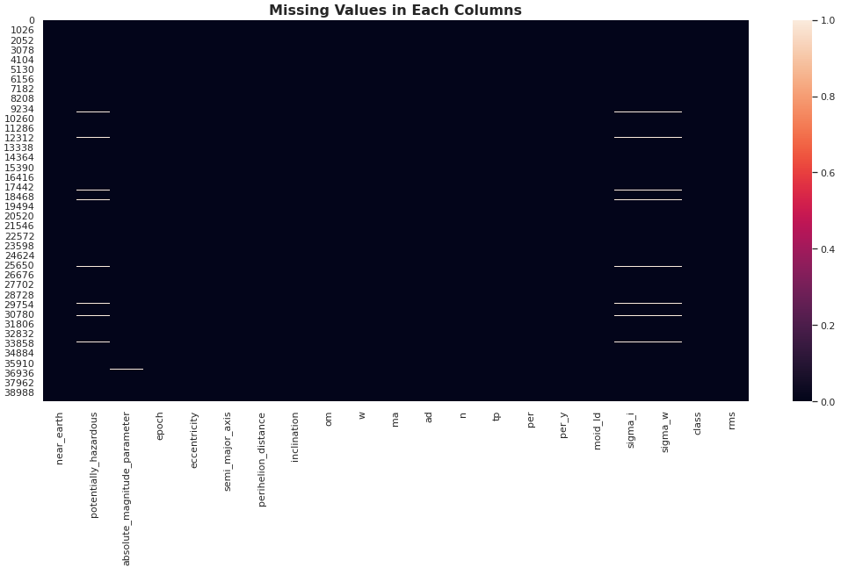
Missing Values

Slide 24
Fill Missing Values in Numerical Columns
Since the distribution of most of the numerical variables do not follow the normal distribution, so it is better to fill the missing values with median since it is a robust estimate to outliers.

Slide 25
Categorical Variable Encoding and Casting
potentially_hazardous & near_earth
→ Encode ‘Y’ and ‘N’ to 1 and 0
class
→ Encode 11 categorical values into numbers ranging from 0 until 10.

Slide 26
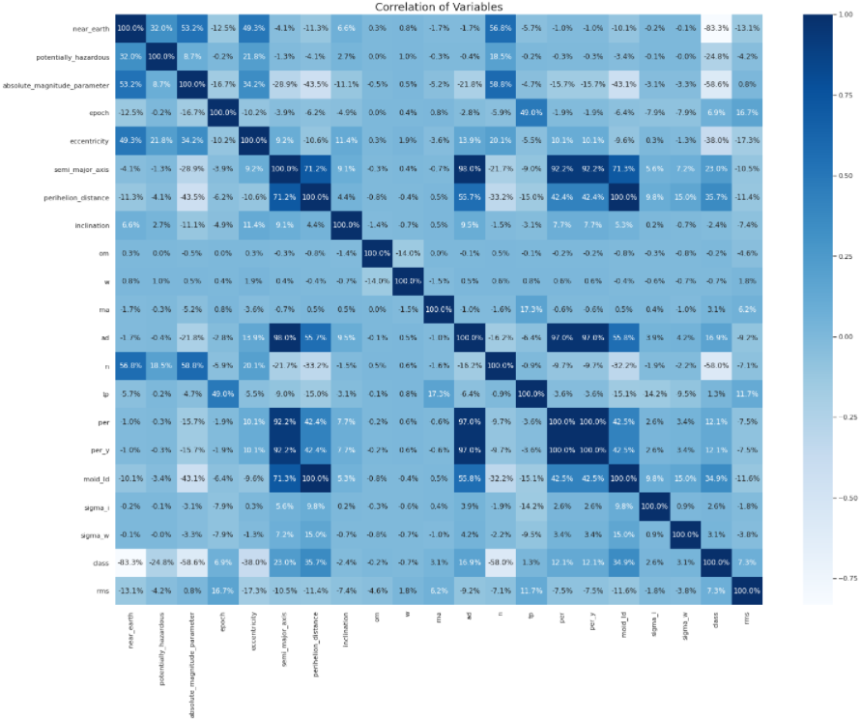

Slide 27
MODELING AND EVALUATION

Slide 28
MODELS
Logistic Regression
Gaussian Naïve Bayes
K-Nearest Neighbors
Decision Tree
Random Forest
XGBoost
CatBoost
LightGBM

Slide 29
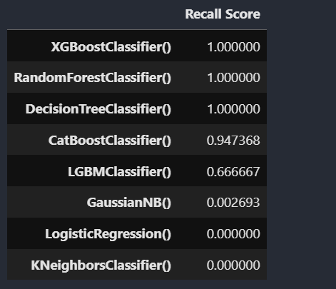
MODEL EVALUATION

Slide 30
CONCLUSION AND RECOMMENDATION

Slide 31
CONCLUSION
Based on the table in the previous slide, we can see that XGBoost, Random Forest, and Decision Tree are the best models for this asteroid classification. From the prediction result, most of the asteroids are not hazardous to Earth.
RECOMMENDATION
This project will be much better if the name of features are clearer so that we can know and understand better about the dataset in general. Good hyperparameter tuning will also make the predictions better.

Slide 32
THANK YOU!

